Slide 1
COEN 275 Object-Oriented Analysis, Design and Programming (4 units)
Paddu Melanahalli
pmelanahalli@scu.edu
School of Engineering/Graduate Engineering

Slide 2
C++ - an Object-Oriented Programming Language
Other examples: C# and Java
The modern approach to developing programs
- Objects in a real-world problem are modeled as software objects
Slide & teaching content is from internet and books – copyright belongs to respective owners.

Slide 3
The Evolution of C++
C (1972)
ANSI Standard C (1989)
Bjarne Stroustrup adds features of the language Simula (an object-oriented language designed for carrying out simulations) to C resulting in …
C++ (1983)
ANSI Standard C++ (1998)
ANSI Standard C++ [revised] (2003)
ANSI Standard C++ (2011)
The present C++
A general-purpose language that is in widespread use for systems and embedded
The most commonly used language for developing system software such as databases and operating systems
… the future: another Standard (2022?)

Slide 4
What are the Key Ingredients of a Program?
Common elements in programming languages:
Keywords (aka reserved words)
Defined in C++. Have a special meaning
Programmer-defined entities
Names made up by programmer
Used to represent variables, functions, etc.
Operators
Defined in C++
For performing arithmetic, comparison, etc. operations
Constructs
• Defined in C++
• Sequence, selection, repetition, functions, classes, etc.
Every programming language has a syntax (or grammar) that a programmer must observe
The syntax controls the use of the elements of the program

Slide 5
Object Oriented Programming
C++ is derived from C programming language – an extension that added object-oriented (OO) features.
- Lots of C++ syntax similar to that found in C, but there are differences and new features.
Popular because of the reuse of objects
Classes – template or blueprint for an object
Objects
Methods
Objects are organized in a hierarchy
Super Classes
Sub Classes

Slide 6
Program Organization
Program statement
Definition, e.g. function prototype
Declaration, e.g. variables and constants
Action
Executable unit - Action
Set of program statements – may be named
Different languages refer to named executable units by different names
Subroutine: Fortran and Basic
Procedure: Pascal
Function: C++
Method: C++, C#, Java

Slide 7
Software Development Cycle
IDE

Slide 8
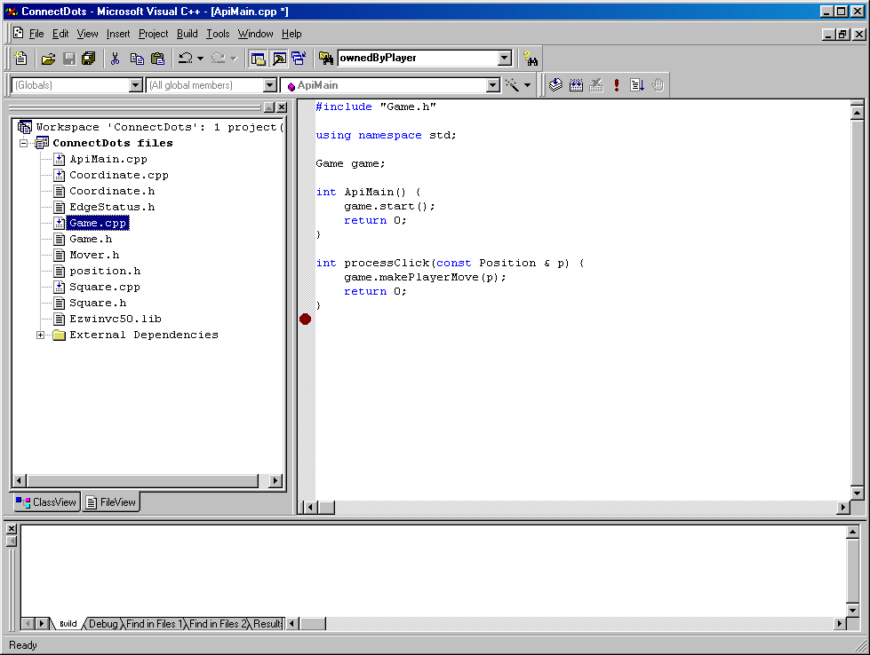
IDEs
Integrated Development Environments or IDEs
Supports the entire software development cycle
E.g. MS Visual C++, Borland, Code Warrior
Provides all the capabilities for developing software
Editor
Compiler
Linker
Loader
Debugger
Viewer

Slide 9
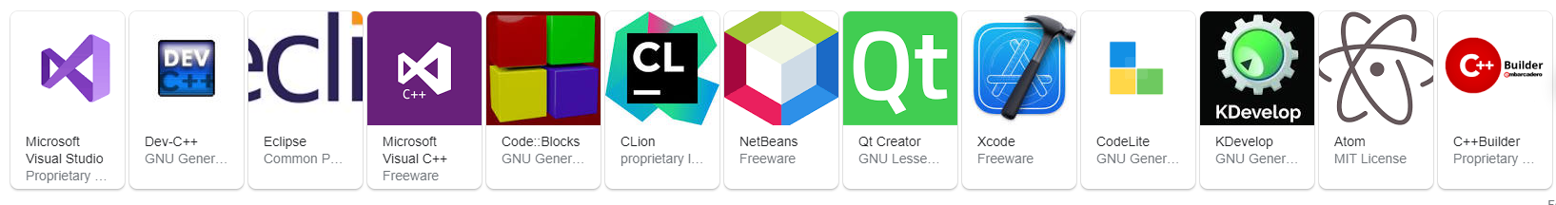

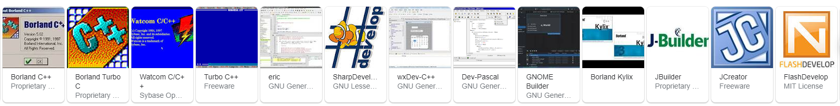

Integrated development environment Software/c++

Slide 10
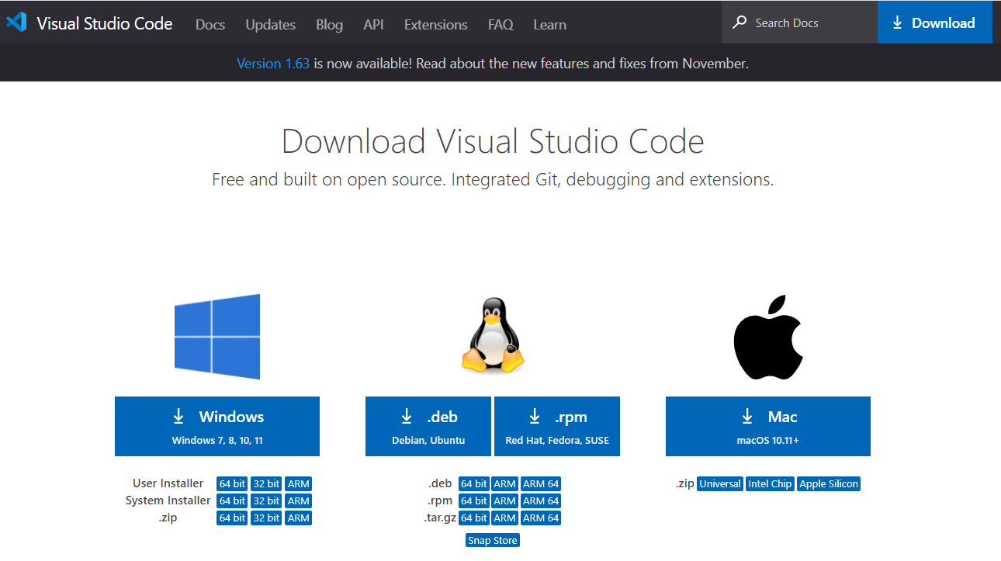
Development Environment
IDE – Integrated development application (A comprehensive tool for software development)
Visual Studio Code
Visual Studio
Eclipse
Visual Studio code
VS Code is a free code editor runs on
Windows
macOS
Linux
Lightweight & runs on most of the hardware
Supports Portable mode ( eg: USB)
https://code.visualstudio.com/download
Download
Install it on your laptop

Slide 11
Using GCC / GDB with MinGW
Install Visual Studio Code
Install C/C++ Extension for VS Code
Get the latest version of minGW-w64 - https://www.msys2.org/
Download - https://github.com/msys2/msys2-installer/releases/download/2021-11-30/msys2-x86_64-20211130.exe
Install minGW
Accept the default installation folder C:\MinGW. Do NOT attempt to place in C:\Program Files\MinGW. (location cannot have spaces)
Add the path to your MinGw
In the Windows search bar, type 'settings' to open your Windows Settings.
Search for Edit environment variables for your account.
Choose the Path variable and then select Edit.
Select New and add the MinGw-w64 destination folder path to the system path. The exact path depends on which version of Mingw-w64 you have installed and where you installed it. If you used the settings above to install Mingw-w64, then add this to the path: C:\mingw64\bin.
Select OK to save the updated PATH. You will need to reopen any console windows for the new PATH location to be available.
Check your MinGw installation

Slide 12
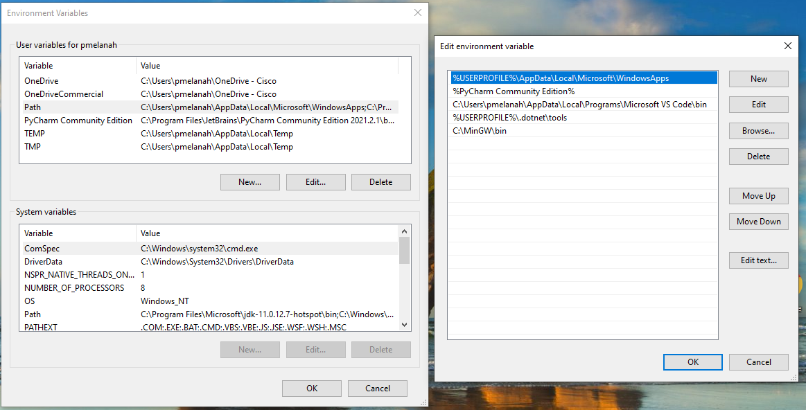
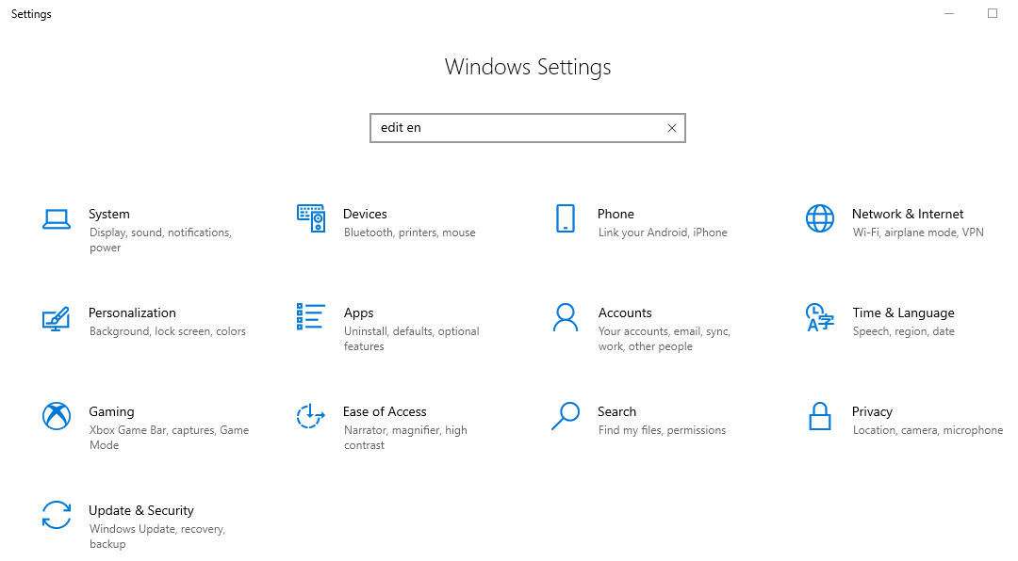
Path Setting

Slide 13
Compiler
Linux or macOS, have a C++ compiler already installed. Most Linux distributions have the GNU Compiler Collection (GCC) installed and macOS users can get the Clang tools with Xcode.
Check
g++ --version
clang –version
If Clang isn't installed, enter the following command to install the command line developer tools:
xcode-select --install

Slide 14
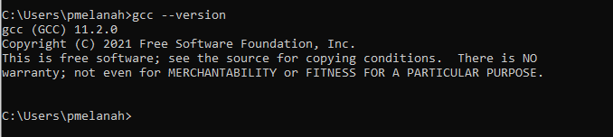
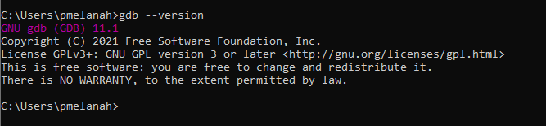
GCC & GDB

Slide 15

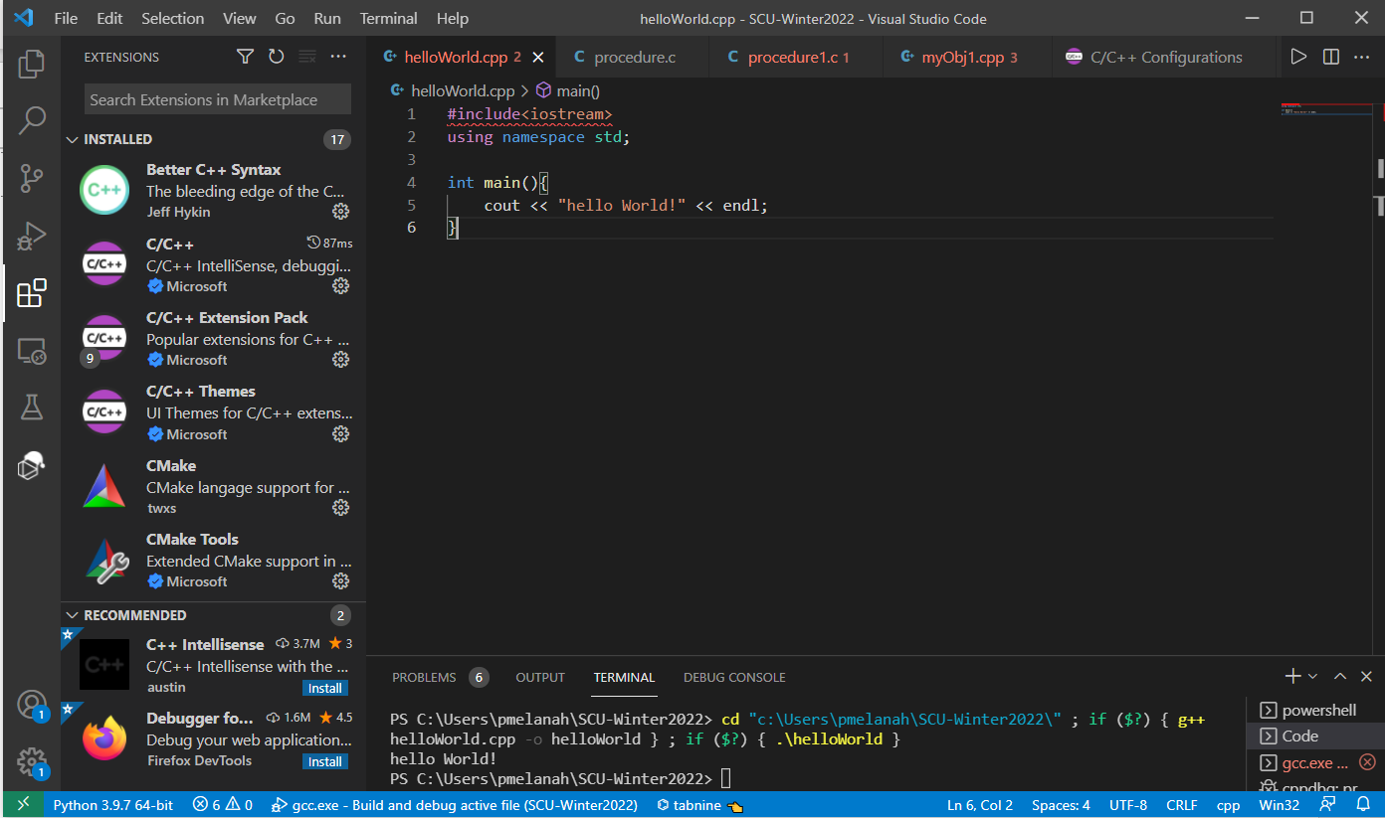
VS code after installation
Visual Studio Code is a source-code editor made by Microsoft for Windows, Linux and macOS. Features include support for debugging, syntax highlighting, intelligent code completion, snippets, code refactoring, and embedded Git

Slide 16
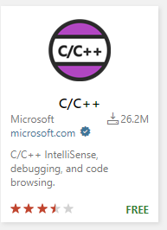
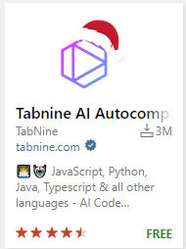
Compiler & other extensions for VS Code
VS Code extensions supports 3rd party utilities
Languages – C++, C#, Go, Java, Python
Tools – ESLint, JSHint, Powershell
Debuggers – PHP Xdebug
Keymaps – Vim, Sublime Text, IntelliJ, Emacs, Brackets, VS, Eclipse
VS code marketplace - https://marketplace.visualstudio.com/vscode

Slide 17
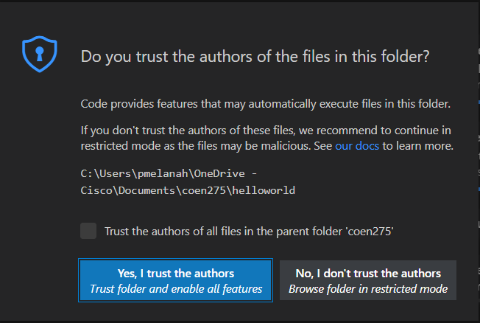
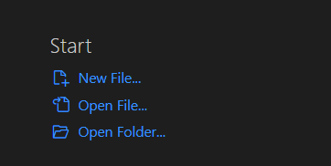
My First C++ Program
Create a Hello World c++ Program
create coen275 folder
cd coen275
mkdir <project name>
Cd <project name>
Start coding!

Slide 18
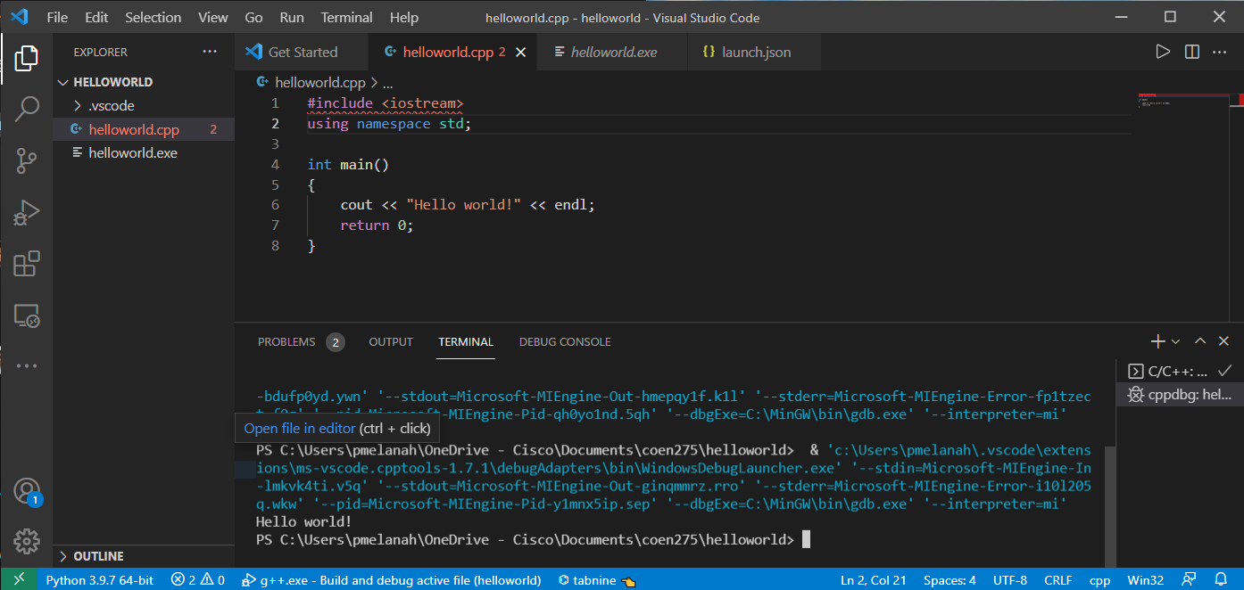
Hello World!
Resource: https://code.visualstudio.com/docs/introvideos/basics
Video - https://code.visualstudio.com/docs/cpp/introvideos-cpp
Ctrl+Shift+B : Build the target
Ctrl+F5 : run the program

Slide 19
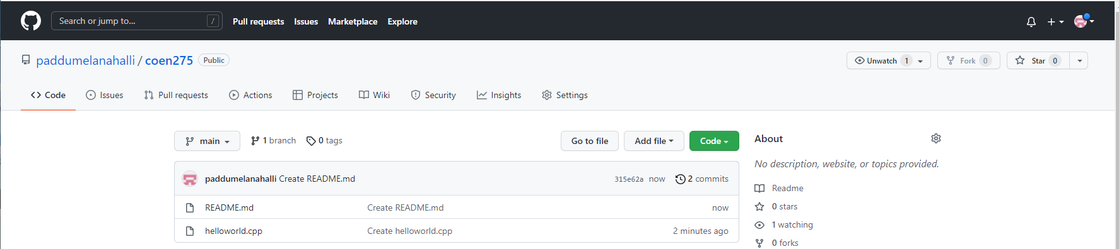
Github repo
https://github.com/paddumelanahalli/coen275
Complete - 01-05 Programs

Slide 20
Thank You!

